Slide 1
Fundamental Principles of Software Testing
Lecture 2
Madiha Malik

Slide 2
Exercise
Move a file from folder A to folder B
Notes:
Consider a scenario where you are moving a file from folder A to Folder B.Think of all the possible ways you can test this.
Apart from the usual scenarios, you can also test the following conditions

Slide 3

Scenario
Try to move the file when it is open
You do not have the security rights to paste the file in Folder B
Folder B is on shared drive & storage capacity is full
Folder B already has a file with the same name
Notes:
infact the list is endless

Slide 4
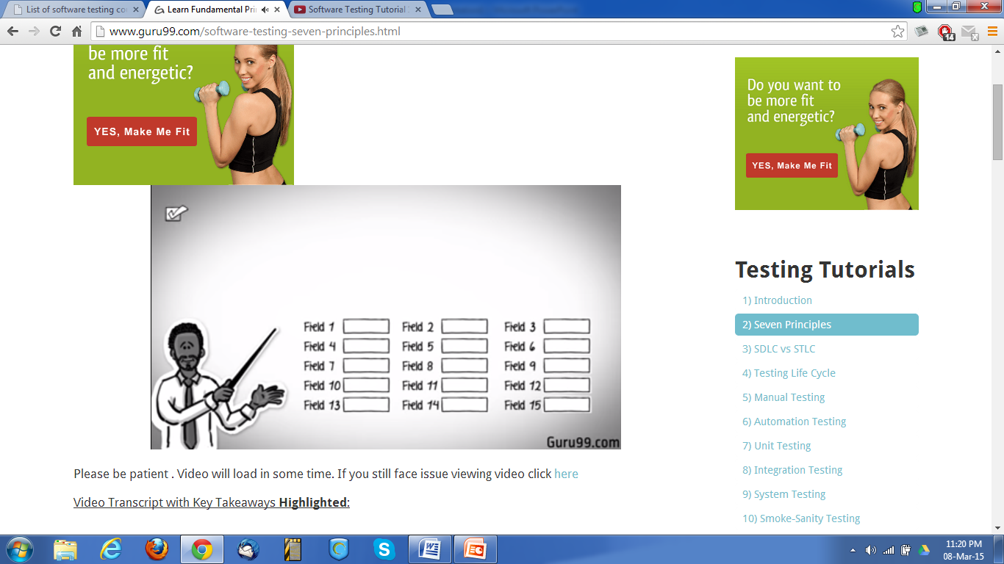
Or suppose you have 15 input fields to test ,each having 5 possible values , the number of combinations to be tested would be
5^15=30 517 578 125!!

Slide 5

If you were to test all the possible combinations, project Execution time & cost will rise exponentially
How do you determine this risk?
Hence, one of the testing principles states that Exhaustive testing is not possible.
Instead we need optimal amount of testing based on the risk assessment of the application.

Slide 6
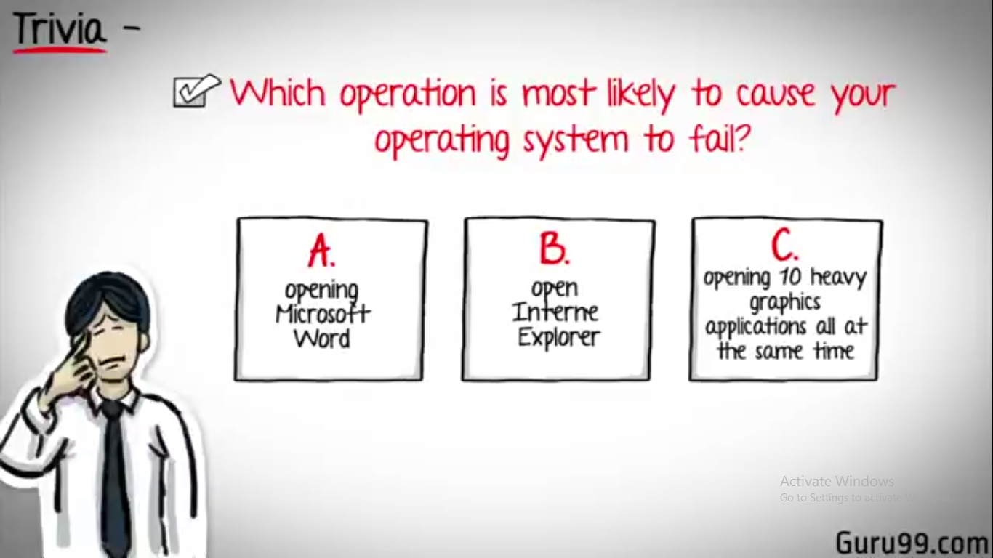
Notes:
To answer this lets do an exercise
In your opinion, Which operations is most likely to cause your Operating system to fail?

Slide 7
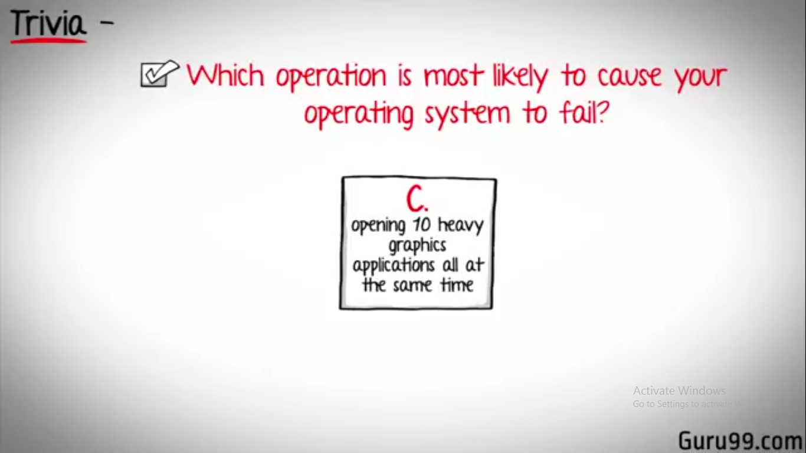
So if you were testing this Operating system you would realize that defects are likely to be found in multi-tasking and needs to be tested thoroughly which brings us to our next principle Defect Clustering
Multi-tasking
Notes:
most of you would have guessed, Opening 10 different application all at the same time.

Slide 8

Defect Clustering
Which states that the majority of the defects are caused by a small number of modules, i.e. the distribution of defects are not across the application but rather centralized in limited sections of the application.
Notes:
By experience you can identify such risky modules.

Slide 9

Pesticide Paradox
If the same tests are repeated over and over again , eventually the same test cases will no longer find new bugs
This is the another principle of testing called “Pesticide Paradox’’
To overcome this, the test cases need to be regularly reviewed & revised , adding new & different test cases to help find more defects.

Slide 10

You can not claim that your product is
BUG-FREE
Notes:
But even after all this sweat & hard work in testing, you can never claim you product is bug free.
You think a company like MICROSOFT would not have tested their OS thoroughly & would risk their reputation just to see their OS crashing during its public launch!

Slide 11

Testing shows presence of Defects
Hence, testing principle states that - Testing shows presence of defects i.e. Software Testing reduces the probability of undiscovered defects remaining in the software but even if no defects are found, it is not a proof of correctness.
Notes:
Hence, testing principle states that

Slide 12

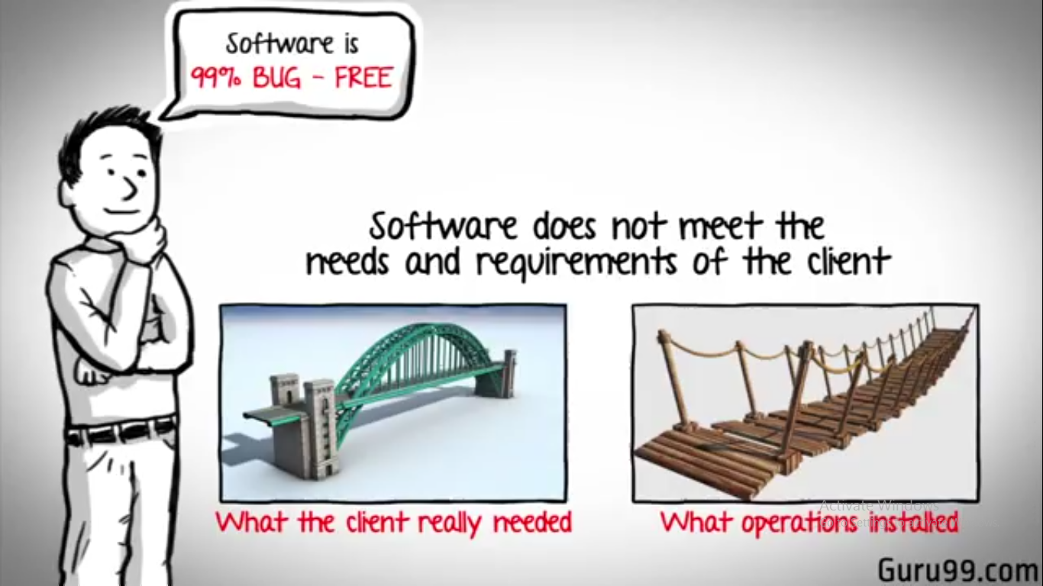
Software is
99% BUG-FREE
Absence of error is a Fallacy
Software Does not meet the needs and requirements of the client
Notes:
But what if , you work extra hard , taking all precautions & make your software product 99% bug free .And the software does not meet the needs & requirements of the clients.
This leads us to our next principle, which states that- Absence of Error is a Fallacy i.e. Finding and fixing defects does not help if the system build is unusable and does not fulfill the users needs & requirements
To fix this problem , the next principle of testing states that

Slide 13
Early Testing
Testing should start as early as possible in the Software Development Life Cycle.
Notes:
so that any defects in the requirements or design phase are captured as well more on this principle in a later training tutorial.

Slide 14

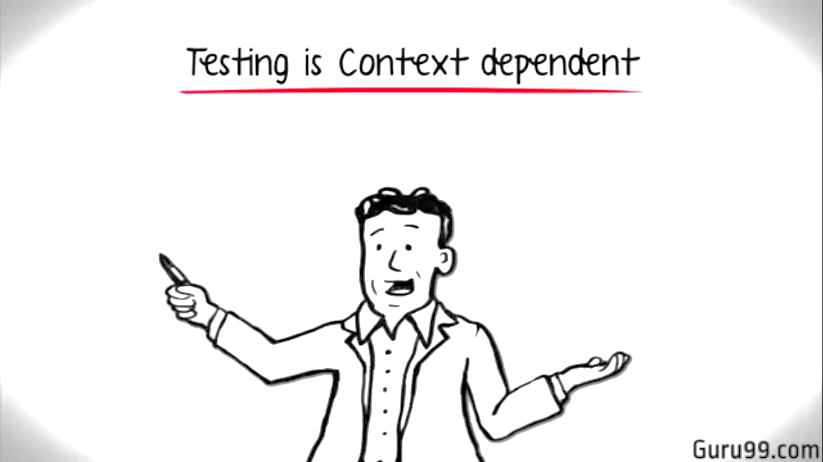
Testing is Context Dependent
Notes:
And the last principle of testing states that the Testing is context dependent which basically means that the way you test a e-commerce site will be different from the way you test a commercial off the shelf application

Slide 15
